Slide 1
MIAC and NASA Education Benita P. Bell
NASA HQ Office of Education
April 15, 2012
Notes:
Working together to enhance STEM literacy

Slide 2
A TEAM APPROACH
The purpose of a collaborative is a team approach to
solving problems
Collaborative provides optimal potential for successful
outcomes
Global vision and diverse approach to address the most
important questions in the history of science
Leverage existing resources for mutual benefical
outcomes

Slide 3
MIAC Vision Statement
A virtual collaboration of Minority Serving
Institutions with the goal to enhance research
and education in Astrobiology and advance
STEM education, the STEM pipeline and STEM
careers.
Exciting and Fun Science!!

Slide 4
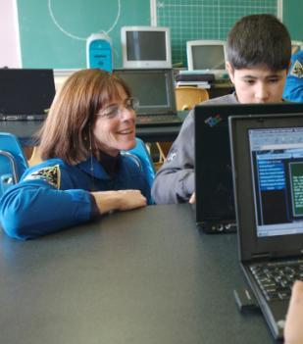
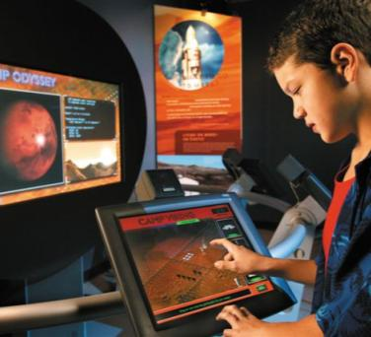
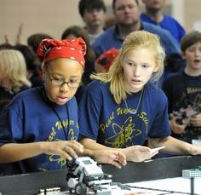
NASA Education Vision Statement
To advance high quality STEM education
using NASA’s unique capabilities
Notes:
From world renowned scientists and engineers to specific missions, NASA truly has the ability to advance STEM education with engaging and innovative education programs. And, we are sharing the majority of these activities via a multitude of platforms for learners of all ages, as well as educators and institutions.

Slide 5
MIAC is unique!
Notes:
Research at MIAC institutions will provide more unique science opportunities to infuse within NASA Education programs(informal and formal, K-12 and Higher Education)

Slide 6
MIAC as a virtual collaboration of MSI’s strengthens the NASA Education mission through its interdisciplinary core focus MIAC is the ideal Partnership Development model to engage underrepresented communities in STEM MIAC researchers have demonstrated successful research outcomes(publications, new laboratories, student training, etc) MIAC and NASA Education initiatives will strengthen STEM literacy MIAC offers cultural and research diversity to enhance OE existing initiatives

Slide 7
MIAC and NASA Education : Why Partner?
The potential for a successful STEM partnership development
model
STEM Education goals aligned; greater recruitment and retention
Interdisciplinary research and education initiatives at Centers
can be strengthened through collaborations with scientists at
MIAC Institutions
MIAC and NASA team building efforts will provide greater
awareness of the Agency’s goals and MSI’s research and
education capacities
Research Diversity for greater global impact in science
Cultural Diversity(students, faculty, NASA scientists) creates
a global vision for science
Notes:
MIAC in partnership with NASA Education will provide greater visibility for faculty and students
Opportunity for enhanced recruitment and retention
STEM pipeline expands

Slide 8
STEM Education Framework
Audiences
Outcomes
Identify, cultivate, and sustain a diverse workforce and inclusive work environment that is needed to conduct NASA missions
Learners
Employ
Educators
Engage the public in NASA’s missions by providing new pathways for participation.
Institutions
Educate
Inform, engage, and inspire the public by sharing NASA’s mission, challenges, and results.
Engage
Build strategic partnerships that promote STEM literacy through formal and informal means.
Inspire
Operating Principles
Relevance • NASA Content • Diversity • Evaluation • Continuity • Partnership/Sustainability
Notes:
4 Major Education Goals:
1-Employ: Cultivate and sustain a diverse workforce.
2-Educate: Attract and retain students in STEM disciplines.
3-Engage: Engage Americans in NASA’s mission through new pathways for participation
4- Inspire: Build strategic partnerships that promote and inspire STEM literacy.
5-Shows rationale for MIAC partnering with NASA Education

Slide 9
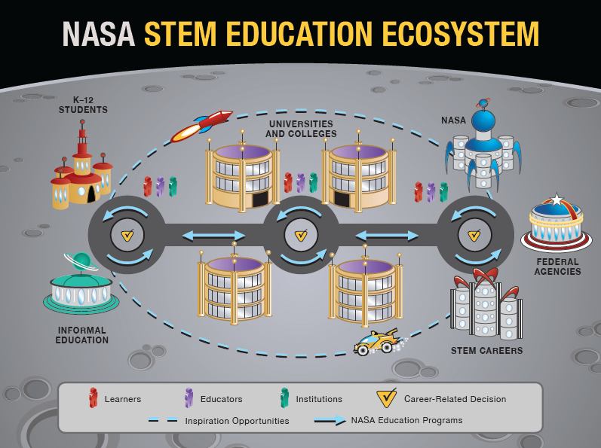
NASA STEM Education Ecosystem
DOE, NSF, NIH, OSTP,
USDA
- Teachers
- Faculty
- Students
- NASA Education Programs
- NASA Career related decisions
3/30/03
Notes:
The STEM Ecosystem is quite large and NASA’s involvement is seen from K-12 to partnerships and collaborations with other federal agencies. MIAC involvement would strengthen this existing structure.
Our primary audiences are learners, educators and institutions, and in this ecosystem you’ll see that they are all interrelated.

Slide 10
STEM EDUCATION Portfolio Priorities
Effective K-12 STEM Teacher Education
Engagement in STEM
Undergraduate STEM Education
Serving Groups Traditionally Underrepresented in
STEM fields
Notes:
Federal STEM Education Portfolio Priorities believes in federal STEM collaboration; that the federal government, through coordinated and collaborative interagency efforts, can achieve significant, measurable impacts in STEM education.

Slide 11
STEM Education Programs…
Diversity is Key(MIAC)
Minority University Research and Education Program (MUREP)
Engages underrepresented populations through a variety of initiatives.
Recruits underrepresented and underserved students in STEM disciplines through completion of undergraduate or graduate degrees
Works with Historically Black Colleges and Universities, or HBCUs; Hispanic Serving Institutions, or HSIs; and Tribal Colleges and Universities, or TCUs
Notes:
MUREP: As highlighted with OSSI and with the student ambassadors, the Office of Education is strengthening involvement with higher education institutions to ensure that NASA can meet future workforce needs in STEM. Furthermore, we are working to ensure that underrepresented and underserved students participate in NASA education and research projects to assist them in their pursuit of STEM careers. The Higher Education Program will continue to focus on the Minority University Research and Education Program, or MUREP, thereby enhancing the capabilities of Historically Black Colleges and Universities, or HBCUs; Hispanic Serving Institutions, or HSIs; and Tribal Colleges and Universities, or TCUs. In addition, the Office of Education encourages these institutions to collaborate with teacher preparation programs that improve the quality and diversity of STEM teachers.
AIHEC Logo: American Indian Higher Education Consortium -MUREP Structure: MUREP engages underrepresented populations through a wide variety of initiatives. Multiyear grants are awarded to assist Minority Institution faculty and students in research of pertinent missions. The program focuses on recruiting underrepresented and underserved students in STEM disciplines through completion of undergraduate or graduate degrees in support of their entry into the scientific and technical workforce.
PLEASE NOTE: This slide closes out NASA Education Programs. The next section focuses on engaging activities and collaborations that NASA Education has.

Slide 12
STEM Education…Crosses Geographical and Cultural Boundaries
2011 International Astronautical Congress in S. Africa
Notes:
- Optional slides if we want to highlight international education with K-12 students.
-STEM education is not just a US-based endeavor; the importance of STEM education is recognized globally and NASA is making sure it does its part internationally too. MIAC institutions provide global diversity in research and education
-NASA Education hosted the 62nd IAC, granting heads of agencies an opportunity to discuss the ISS as a unique tool for STEM education. --- NASA also visited local S. African schools to engage learners with STEM concepts.

Slide 13
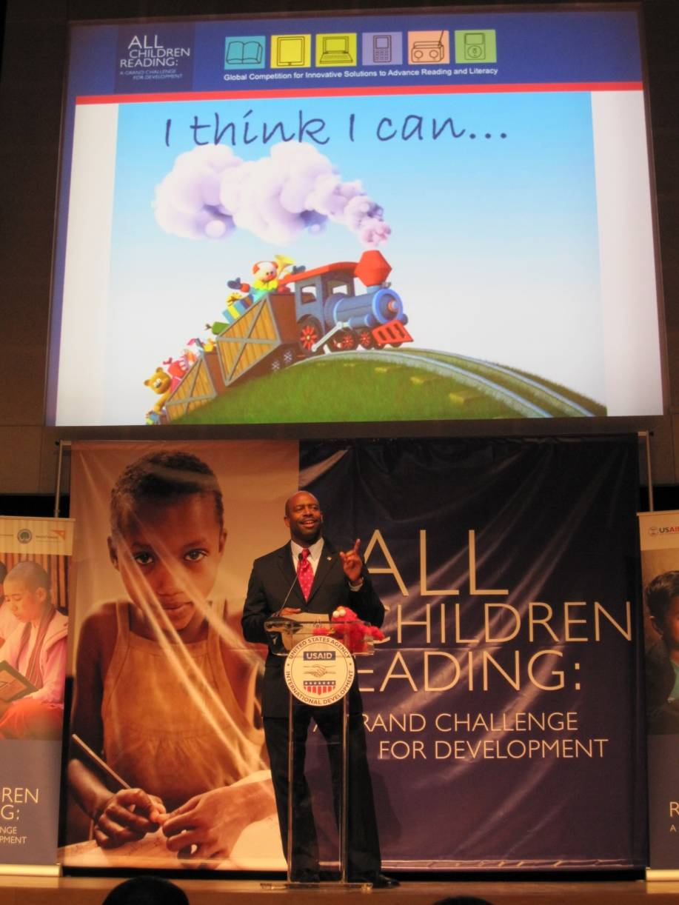
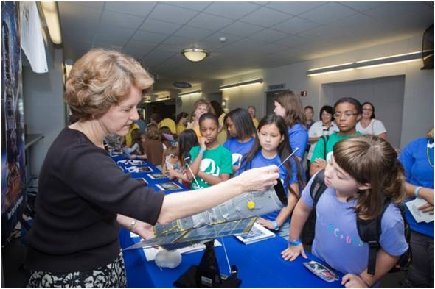
STEM Partnerships…Reaching Learners, Educators and Institutions
Notes:
-The next set of slides will focus on our partnerships and the relevance they have to learners educators and institutions.
-NASA is seeking collaborations with organizations in order to reach new or broader audiences across a national scale. Our collaboration announcement was released last year and will be open through June 30.
As mentioned earlier, the collaboration you are forming part of a larger national and even global effort to motivate and inspire students in STEM fields.
100K in 10: The focus of this program is to recruit, prepare, retain, and support 100,000 excellent STEM teachers over the coming 10 years in order to prepare all students with the high-quality STEM knowledge and skills needed to address the most pressing national and global challenges of tomorrow.
All Children Reading Challenge: Is a multi-year initiative. Its mission calls for ground-breaking solutions that offer scalable, cost-effective innovations. NASA is taking part in addressing this global problem.
Other Partnerships NOT YET Solidified: (These are items mentioned by Diane Clayton)
Laying the Foundation sent their information and this collaboration is in the first steps of review. Laying the Foundation, a division of the National Math and Science Initiative, is a program dedicated to improving the teacher corps in the U.S. They provide effective teacher training and mentoring, rigorous classroom-ready materials, and web-based resources to improve the quality of math, science, and English instruction in middle school and high school classrooms. This organization would contribute to the Math and Science @ Work Program and the Exploring Math at Work program in JSC.
Other collaborations being reviewed are with National Institute of Business Sciences and Skype.

Slide 14
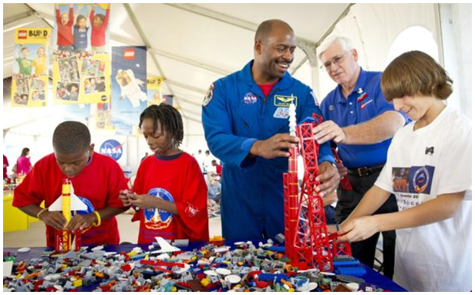
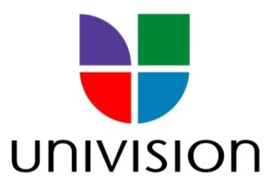
STEM Partnerships…Building the Future Together
Will.I.Am
LEGO
Univision
Notes:
Pop culture personalities: Will I Am of the Black Eyed Peas and Mary J. Blige are encouraging their fans to pursue STEM. In some cases, students might not listen to their teachers or parents, but sometimes a positive culture role model can make a difference. Will I AM’s involvement with FIRST Robotics has been amazing and NASA has reached out to other entertainers too. Last year, music producer Pharrell Williams and NASA hosted an education event in Virginia for more than 500 students. The Pharrell Williams Resource Center will open in 2013 to run academic enrichment programs in STEM.
The LEGO Company: NASA signed a new Space Act Agreement with LEGO to spur children’s interest in STEM. Among the many fun projects this partnership will implement is a challenge to students to solve problems found in microgravity and present solutions to the ISS crew and other students across the nation. Additionally, they have designed a highly interactive Web site featuring astronauts in the ISS.
-Univision: New partnership was recently announced in support of Univision’s educational campaign geared towards Hispanic youth. NASA is making sure all youth demographics are reached through its efforts.

Slide 15
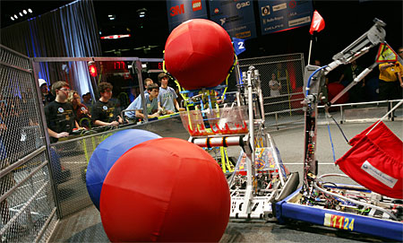
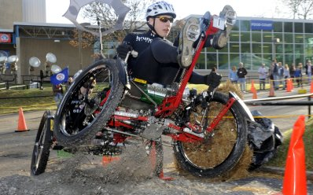
Hands-on STEM Activities Engage Students
MIAC
“Tell me and I'll forget; show me and I may remember; involve me and I'll understand.”
FIRST Robotics
Great Moonbuggy Race
Notes:
-PLEASE NOTE: The FIRST Robotics image will take you to a promo video when clicked. The Moonbuggy image will take you to a Moonbuggy video.
NASA has a multitude of exciting education programs which involve direct STEM learning and hands-on activities. These programs are designed not only to educate but to also drive students into STEM careers. Make sure to inform your students about these activities and how they can sign up online.
FIRST Robotics Competition: We’ve taken a big role in the national FIRST Robotics Competition. Approximately 40 house teams work directly with NASA field centers. And, actually our newest project will overlap directly with robotics. It’s called NASA Robotics Badging
NASA Robotics Badging: Will be implemented through our collaboration with the Badges for Lifelong Learning initiative. To those of you who are not familiar with the concept of badging, it’s an innovative way of indicating one’s level of skill or interest about a variety of topics in the social networking world. In 2012, our goal is to construct NASA’s digital badge set for online learners to continue engaging learners where they are and to continue being on the forefront of STEM education.
-Great Moonbuggy Race: Held every April gives undergraduate and high school students an opportunity to assemble collapsible vehicles, recreating the experience of the Apollo astronauts.
EXTRAS:
EarthKAM: Allows middle school students to program a digital camera on board the space station to photograph geographical targets for study in the classroom.
SPHERES: Gives students a chance to design research for the space station. Part of the competition involves students writing algorithms for the SPHERES satellites to accomplish tasks relevant to future space missions.
HUNCH: Gives students “work-world” experiences by engaging them in design, fabrication and rapid prototyping of products for use in the ARES I mock-up.

Slide 16
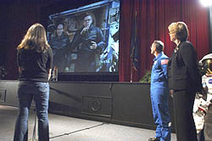
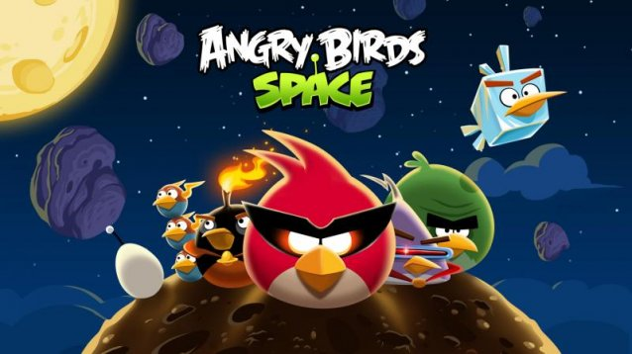
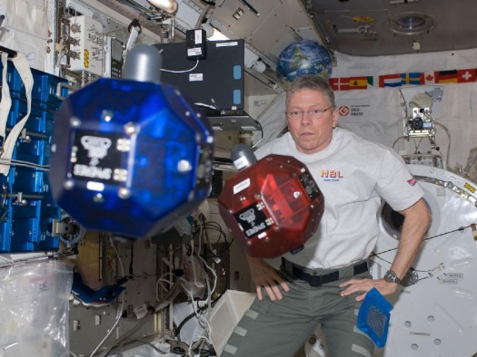
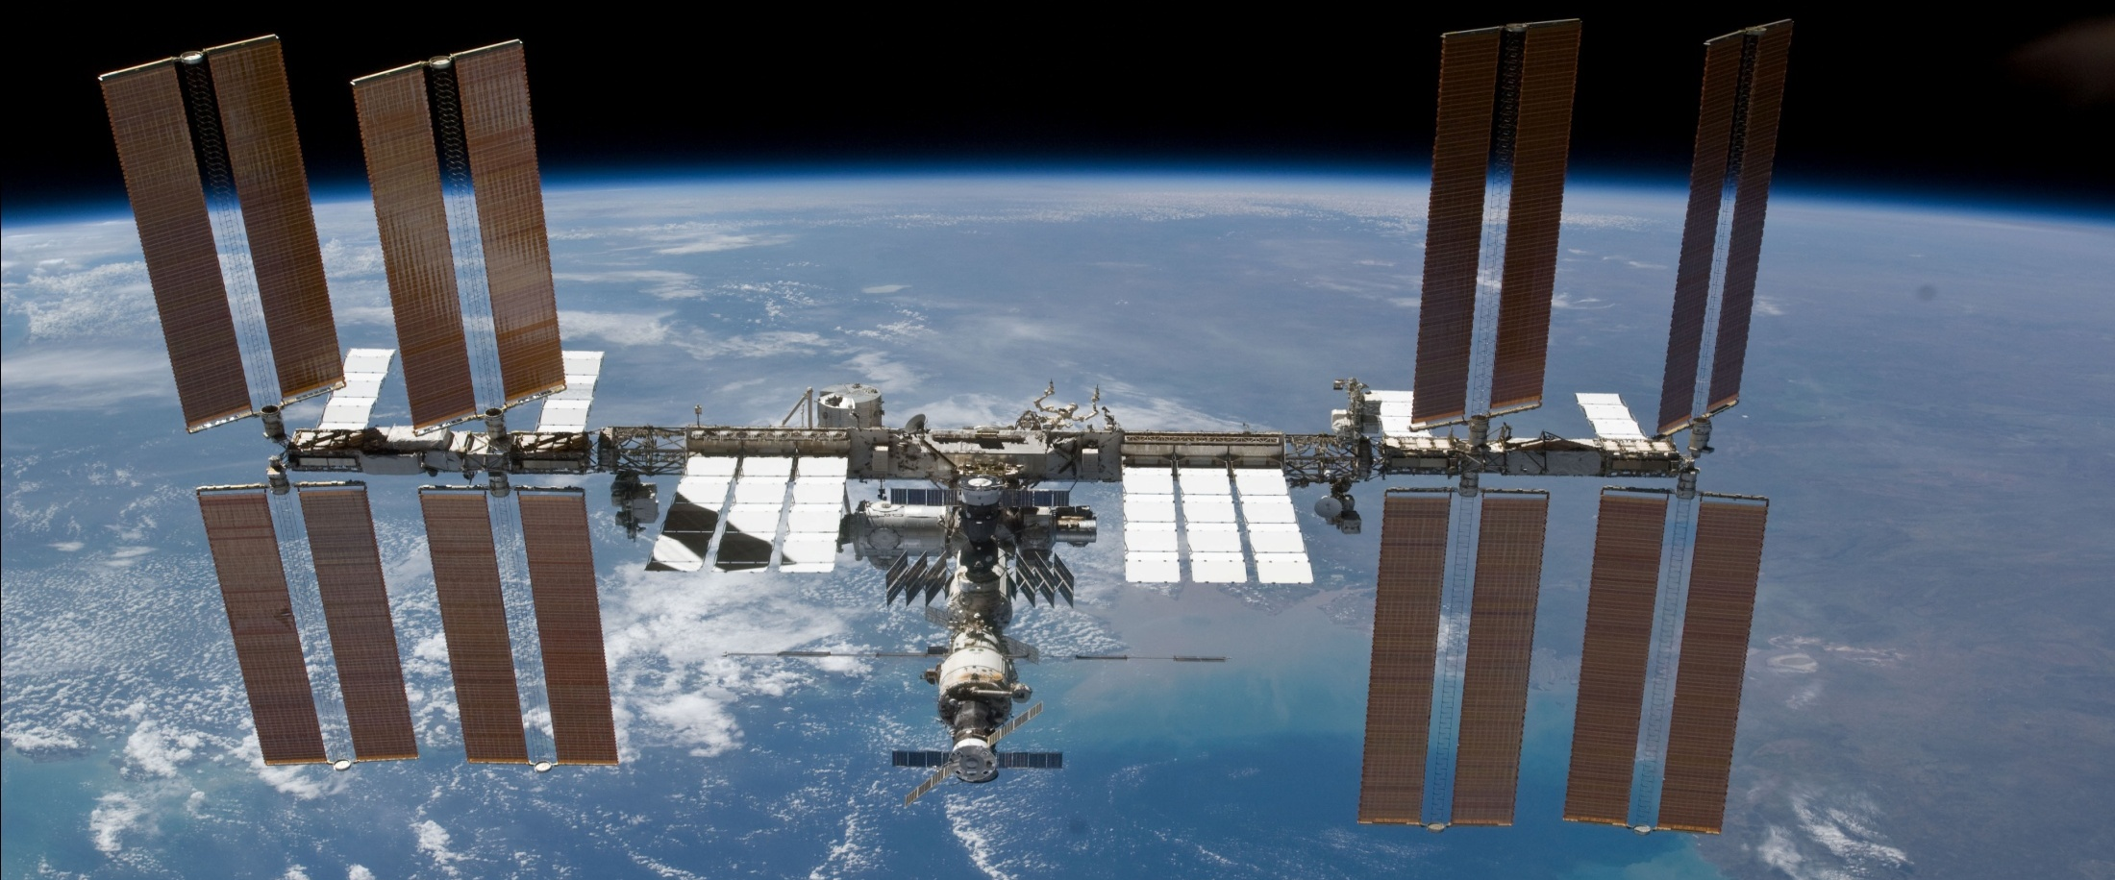
International Space Station…Engaging and Educating
MIAC Students in STEM
Notes:
THE ISS continues to offer a number of STEM learning experiences from downlinks to competitions and just recently to smart phone Apps—Angry Birds.
SPHERES: Gives students a chance to design research for the space station. Part of the competition involves students writing algorithms for the SPHERES satellites to accomplish tasks relevant to future space missions.
Activities like this really put into context what students learn in the classroom.

Slide 17
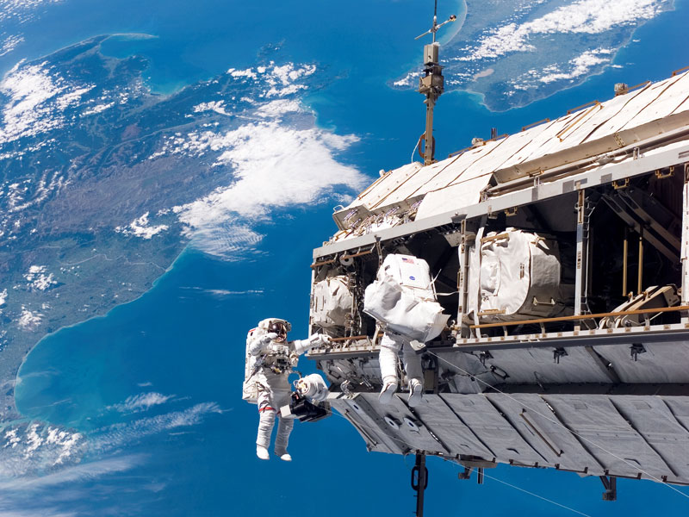
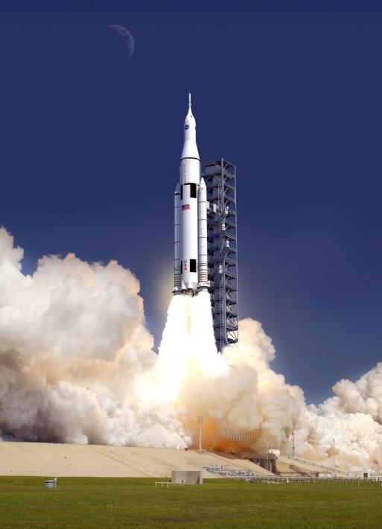
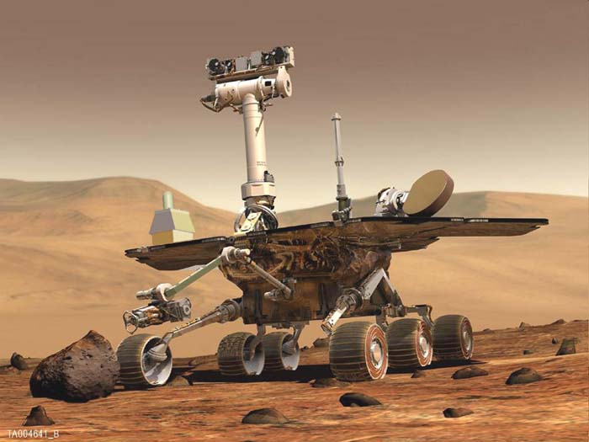
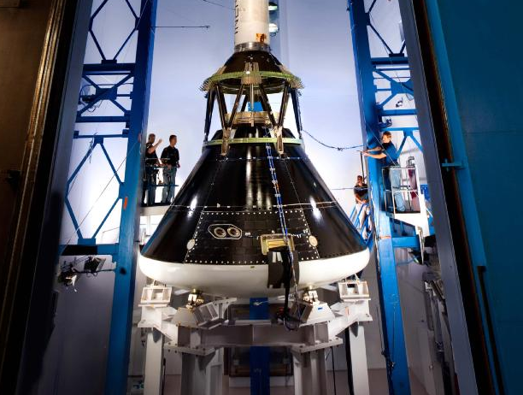
Looking Towards the Future: Opportunities for the Next Generation
International Space Station
New Space Launch System
Mars Science Laboratory
NASA’s ORION
Notes:
-As NASA looks toward the future of STEM education there are several exciting missions and projects that will continue to set the stage to inspire the next generation of STEM leaders.
The possibilities for a child with a STEM education are boundless and this is why we at NASA and educators like you are key players in getting that message out there.
Think about it, the students you work with day-to-day could be the next to walk on Mars!
Mars Science Laboratory: Curiosity will land in the Gale Crater in August 2012 and it will tell us if Mars has ever been hospitable to life.
International space station: ISS will continue to be the center our human spaceflight activities until 2020 and is complete now thanks to the space shuttle.
NASA Space Launch System: Plans to develop the new NASA Space Launch System also made big news. This new system will have an advanced heavy-lift launch vehicle that will provide an entirely new capability for human exploration beyond Earth's orbit. It will expand our reach in the solar system and allow us to explore cis-lunar space, near-Earth asteroids, Mars and its moons and beyond.
NASA’s ORION: In two years, human space exploration will make its biggest leap in more than four decades. Lockheed Martin will conduct the Orion Exploration Flight Test-1, or EFT-1, in 2014 under contract to NASA. NASA is acquiring the EFT-1 test data for Orion design and development. Lockheed Martin is responsible for performing the flight test and supplying the test data to NASA. The test will launch NASA's Orion spacecraft, without a crew, to an altitude that has not been achieved by a craft intended for human flight since the Apollo lunar landing missions.

Slide 18
Minority University Research and Education Programs (MUREP)
An opportunity for MIAC Institutions

Slide 19
What is MUREP?
Currently administered by NASA’s Office of Education
Implemented at the field centers
MUREP increases the Agency’s responsiveness to federal mandates related to minority institutions
Minority Institutions Defined by NASA
Historically Black College or University (HBCU)
Hispanic Serving Institutions (HSI)
Tribal College or University (TCU)
Other Minority Serving Institution (OMU)

Slide 20
Opportunities for MIAC involvement Current MUREP Projects
Curriculum Improvements Partnership Award for the Integration of Research (CIPAIR)
Harriet B. Jenkins Pre-doctoral Fellowship Program (Jenkins)
Motivating Undergraduates in Science and Technology (MUST)
MUREP Small Projects (MSP)
NASA Innovations in Climate Education NICE)
NASA Science Technology Institute (NSTI)
Tribal College and University Project (TCUP)
University Research Center (URC)

Slide 21
NASA Internships, Fellowships and Scholarships
www.intern.nasa.gov
NASA Student Ambassadors...Why Being a NASA Intern is Cool!
Notes:
OSSI, www. Intern.nasa.gov: Provides internships, fellowships and scholarships. NASA has recently selected 100 of their “high-performing interns” to be inducted into the 2012 NASA Student Ambassadors Virtual Community. The Student Ambassadors program is part of NASA’s effort to encourage learning and education in their related fields.
PLEASE NOTE: The pink text will take you to the youtube clip featuring student ambassadors at the Stakeholders’ Summit. This is a long clip--you can close it at 1:50 or earlier based on your preference/remaining presentation time.

Slide 22
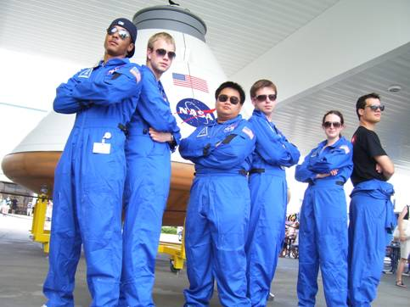
NASA Internship, Fellowships and Scholarships
Students have the ability to search and apply for all types of NASA internships on the OSSI: SOLAR (Student On-line Application for Recruiting Intern, Fellows and Scholars), found through www.intern.nasa.gov
Science
Technology
Engineering
Mathematics
Business
* Fall Student Internships applications are now open until May 31st * Summer 2013 applications will be available November 1, 2012
www.intern.nasa.gov
Notes:
-Students have the opportunity to search for internships that match their disciplines on the SOLAR Web site

Slide 23
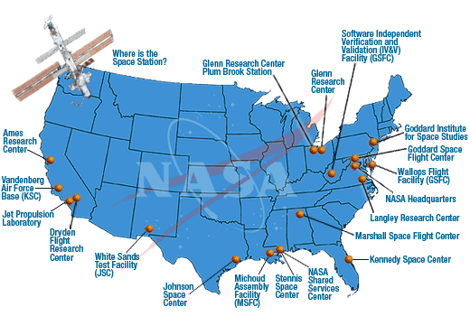
NASA Internship, Fellowship and Scholarship Locations

Slide 24
National Space Grant College and
Fellowship Program
Space Grant contributes to the nation's science enterprise by funding education, research, and public engagement projects through a national network of university-based Space Grant consortia.
Maintains a national network of universities in every state, the District of Columbia and Puerto Rico
Encourages cooperative programs among universities, aerospace industry, and Federal, state, and local governments.
Contact the Space Grant consortium in your state for more information about activities, projects and opportunities available!
Visit education.nasa.gov/spacegrant for more information!
Notes:
Space Grant:
Maintains a national network of universities in every state, the District of Columbia and Puerto Rico
Encourages cooperative programs among universities, aerospace industry, and Federal, state, and local governments.
Promotes a strong science, mathematics, and technology education base from elementary through secondary levels.
Contact the Space Grant consortium in your state for more information about activities, projects and opportunities available!
Highlights of Projects that focus on Middle School Educators include:
The “Middle School High-Altitude Ballooning Initiative” Several teacher participants in this program applied for (and received) mini-grants from the Summer of Innovation program in the summer of 2011 to allow them to pursue additional ballooning-based STEM activities with their students, encouraged and advised by the MNSGC.
Changes in Altitudes, a balloon payload development workshop/launch program Some participants formed the core crew for experiment proposal, design, development and flight on STS-135 through the Student Spaceflight Experiments Program (SSEP).

Slide 25
SUMMARY MIAC and NASA Education
Mutually beneficial partnership to advance STEM

Slide 26
Summary
-A virtual collaborative strengthens interdisciplinary STEM focus
for NASA Education programs at NASA Centers
-Research diversity of MIAC Scientists provides a platform for
partnership development initiatives
-Broadens vision for NASA Higher Education and K-12
Programs
-Collaborative provides a network of MSI’s for NASA Education
to engage faculty and students in exciting, fun and practical
Research
-MIAC is the ideal climate for developing and encouraging
national and international partnerships with MSI’s
-MIAC partnership with NASA OE will enhance funding
Opportunities; generate potential for funding via OE Higher
Education Programs
-Online Mentoring Program for students and faculty engaged
in interdisciplinary research
-MIAC provides a fresh perspective to NASA Education
Initiatives(informal and formal education programs)
Notes:
MIAC initiatives can provide support and professional development for college and university faculty and K-12 teachers to teach new courses in astrobiology and astrobiology related fields.
NASA is committed to STEM Education

Slide 27
Notes:
-Finally, I’d like to leave you with a note that continues to inspire me and that is to “Live Your Dreams.”
-There is no one better than children to communicate this to. Sometimes we can forget how motivational or inspiring it is to hear someone say this to us. Who knows what your words and your work will inspire a child to accomplish someday.
-Thank you again for this opportunity to join you today. On behalf of NASA, again I applaud the work you are doing to inspire our next generation of leaders.

Slide 28
THANK YOU MIAC MEMBERS for 10 years of your commitment to inspire
Happy 10 year Anniversary!

Slide 29
What are Minority Institutions?
Historically Black College or University (HBCU) | Accredited institutions of higher learning established prior to 1964 whose education mission is to provide education to Black Americans.
Hispanic Serving Institution (HSI) | Accredited institutions who at the time of application had an enrollment of undergraduate full-time equivalent Hispanic students of at least 25 percent. Must provide assurance that at least 50 percent of the Hispanic students are low-income.
Tribal College or University (TCU) | An institution of higher education which is formally controlled by the governing body of an Indian tribe
Other Minority Serving Institution (OMU) | Institutions with enrollment of a single underrepresented minority group or groups which exceeds 50 percent of the student enrollment.
Sources: Higher Education Act of 1965
http://www.ed.gov/about/offices/list/ocr/edlite-minorityinst.html
U. S. Department of Education Accredited Post-Secondary Minority Institutions Listing

Slide 30
What are the Federal Mandates?
NASA is committed to fulfilling and implementing the
following three Federal mandates in regards to promoting
equal opportunity for participation in federally-sponsored
programs:
Executive Order 13532: HBCU
Executive Order 13555: Educational Excellence for Hispanic Americans
Executive Order 13592: American Indian and Alaska Native formerly known as the Tribal Colleges and Universities
Executive Orders issued by President Barack Obama; Source: http://www2.ed.gov/about/offices/list/ocr/edlite-minorityinst.html

